Slide 1



A RIVER RUNS THROUGH
THE STORY OF COVID AND WASTEWATER
ERIK REDMAN
TOM WELLS
DANA LEIFERT

Slide 2
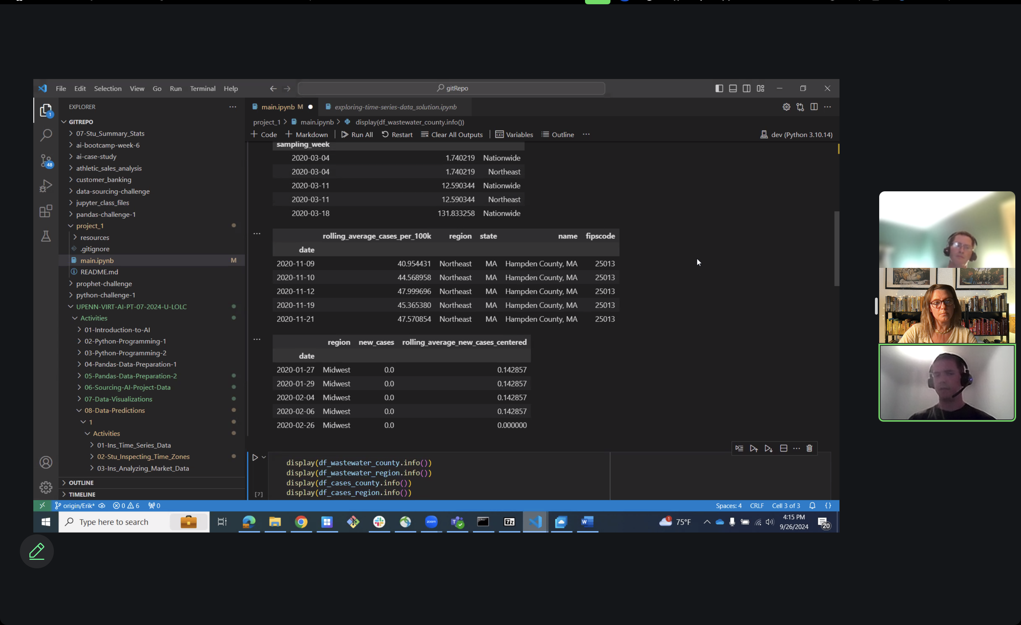
How strong is the connection between human health and their impact on the environment?
Is it important to monitor wastewater for public health?
What data is beneficial to support monitoring wastewater?
Reported Cases of Covid
&
Antigens tested in wastewater
Does a state’s population with covid directly show by the antigens in wastewater?
Data aggregated at U.S. County and Census Region levels.

Slide 3
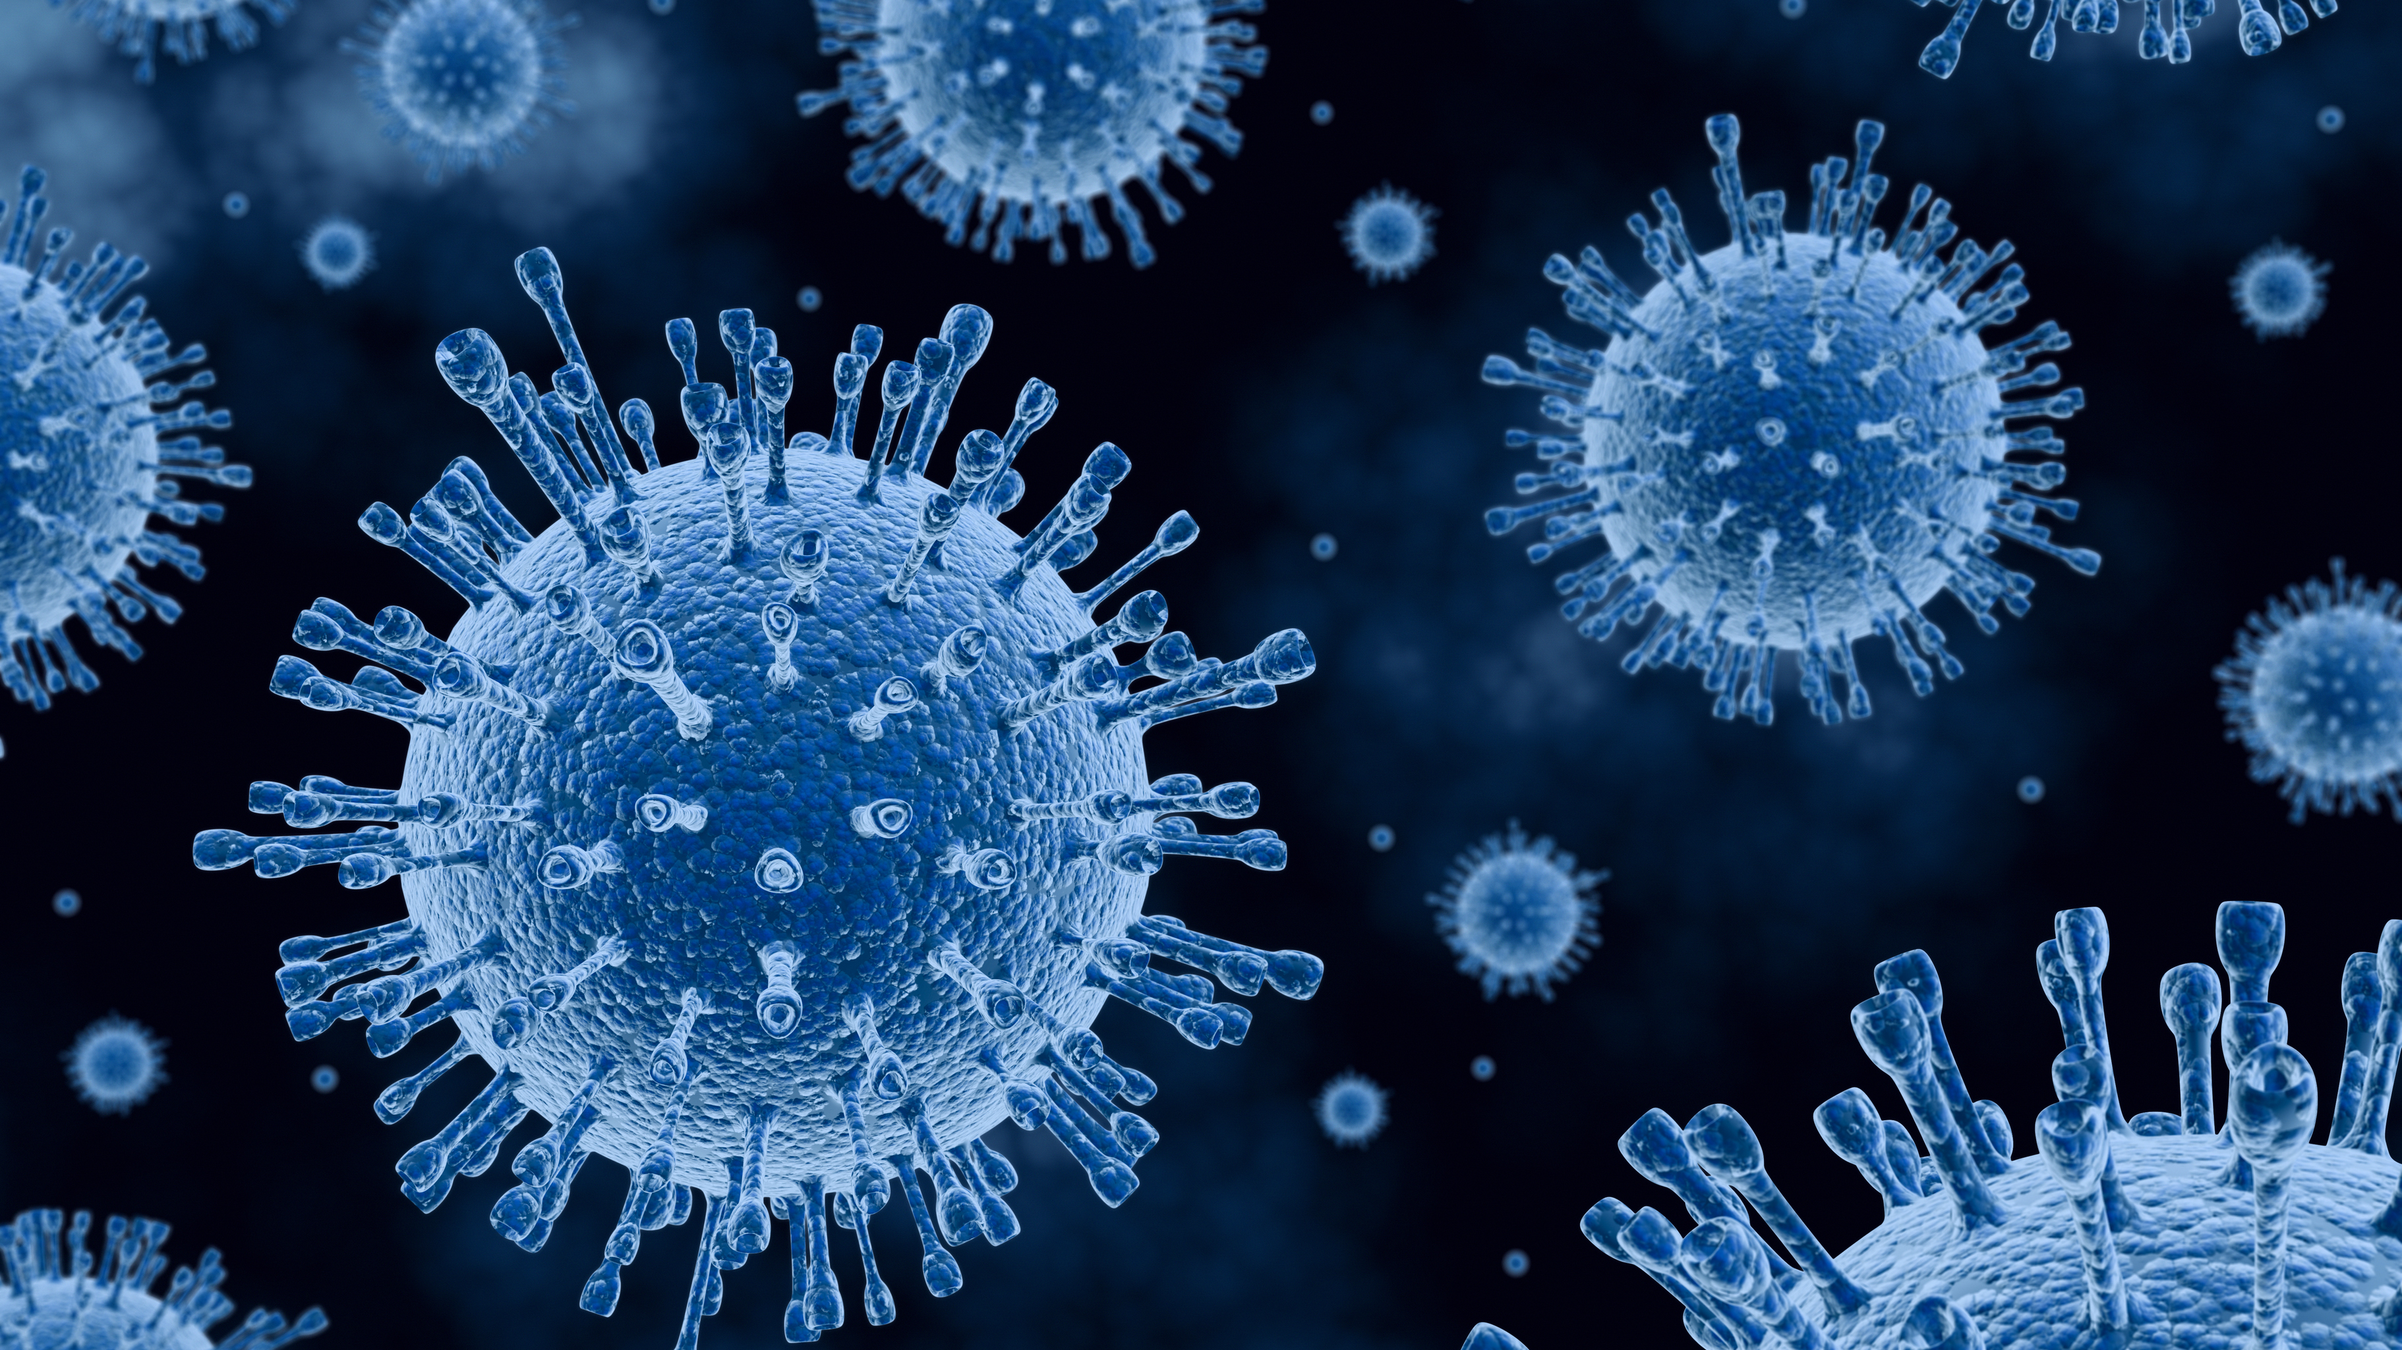
The devil is in the detail An antigen is a molecule or particle that is a foreign substance to the body, binds to an antibody and causes an immune response.

Slide 4

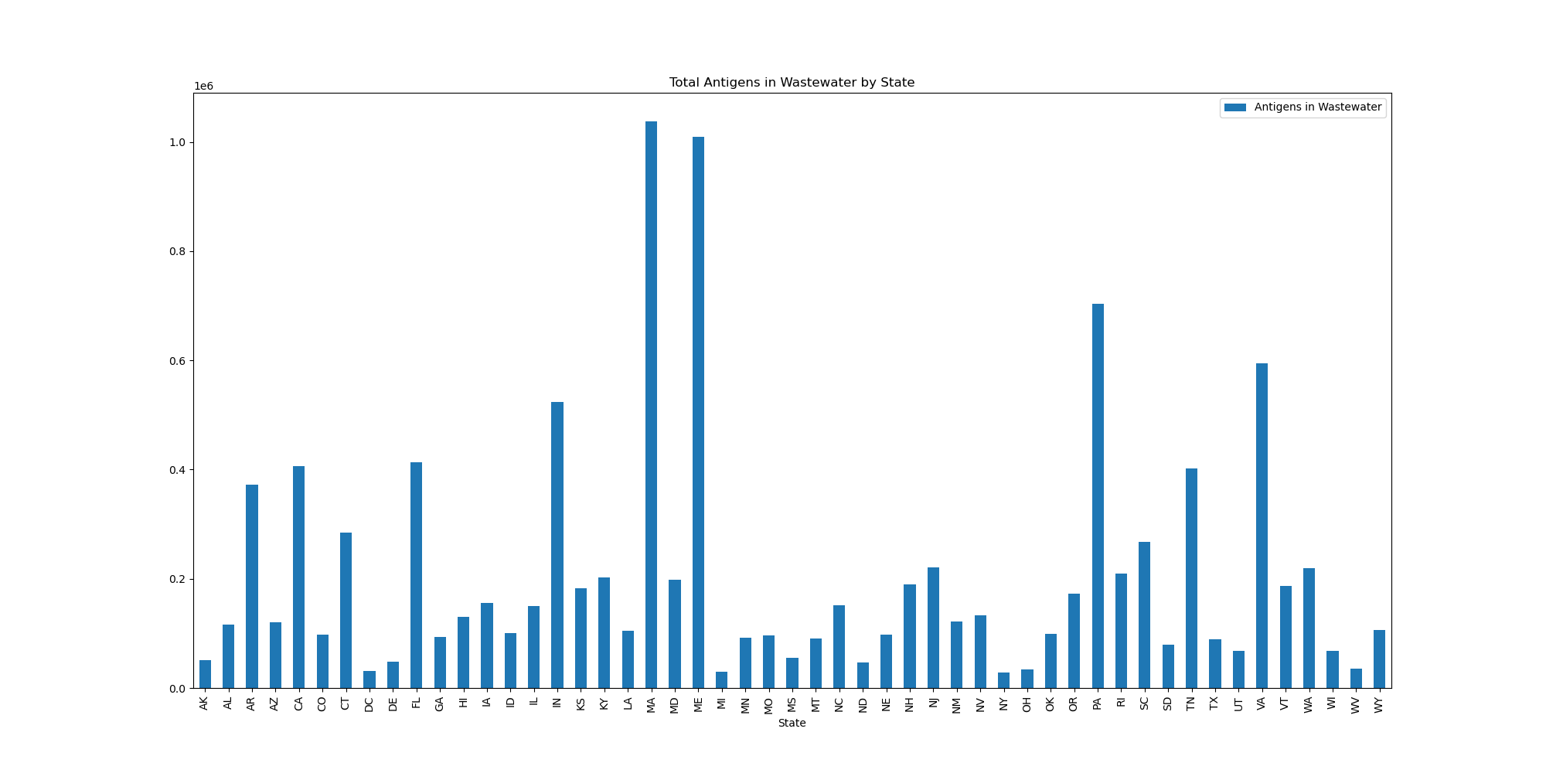
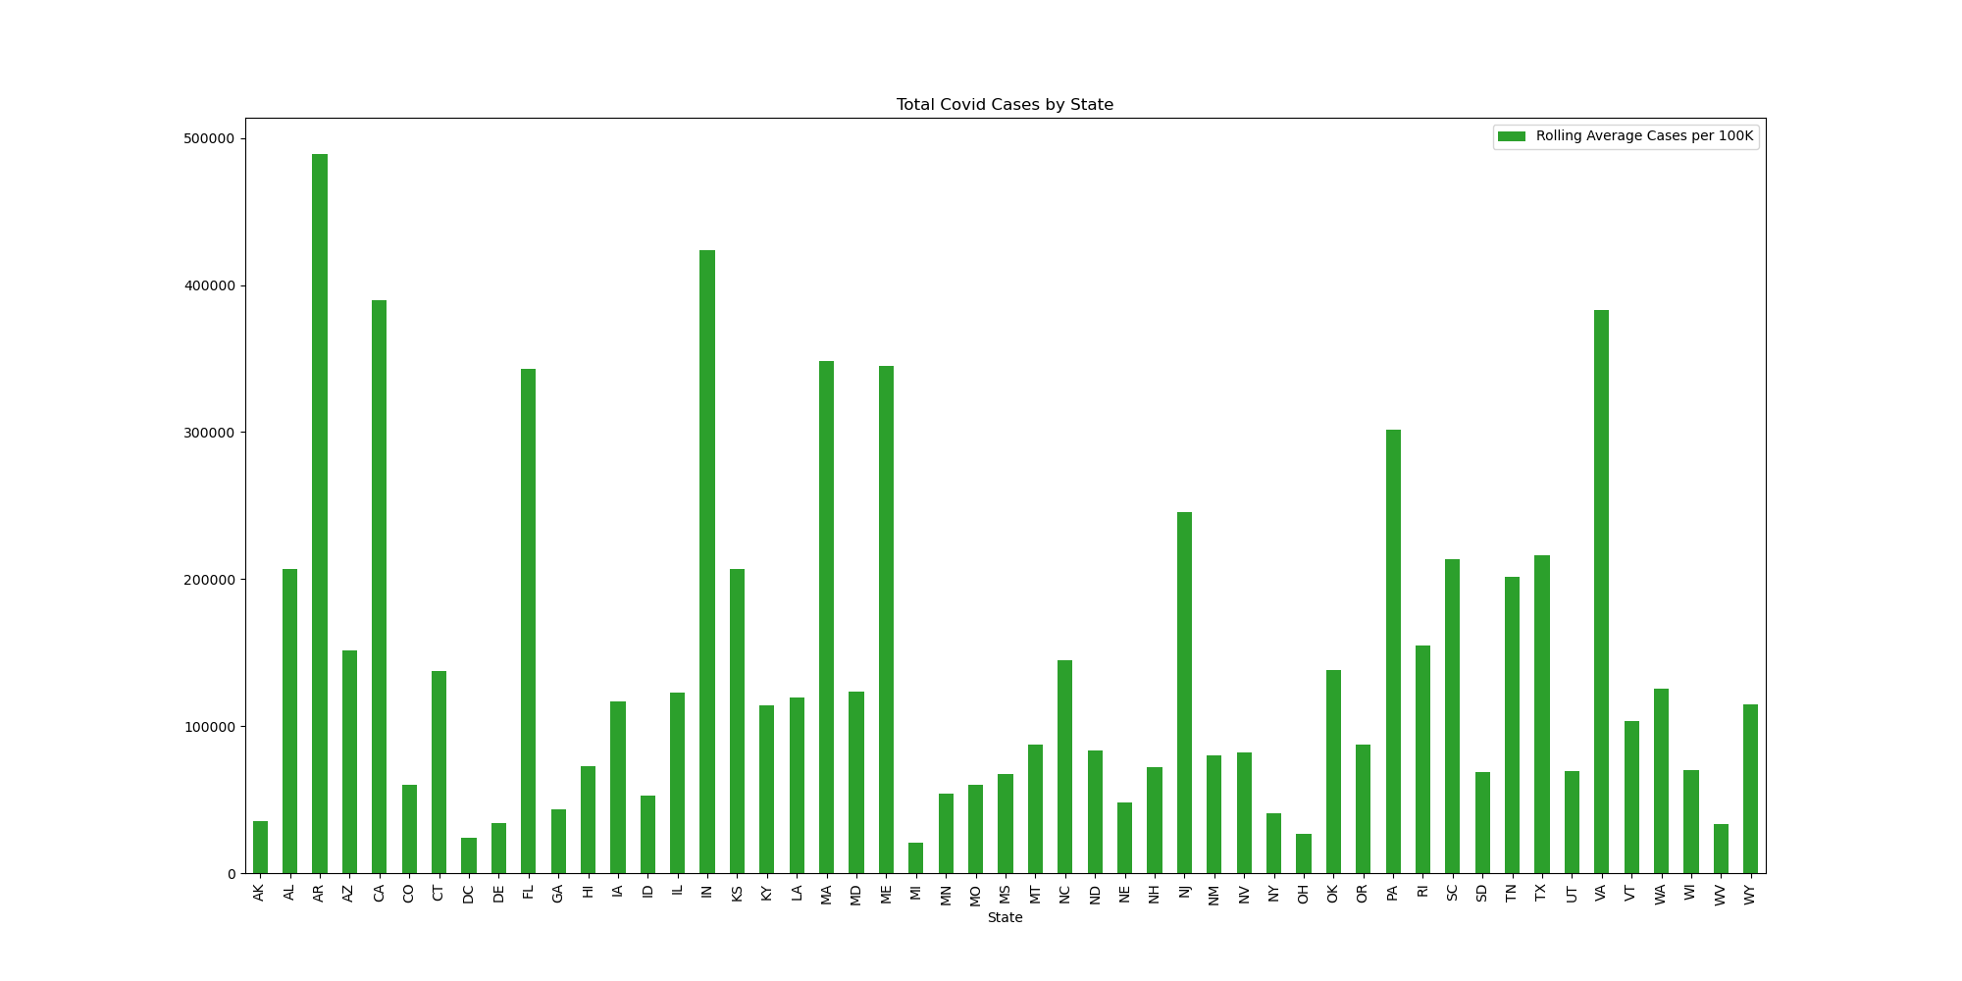

Total Antigens in Wastewater by State
Total Covid Cases by State

Slide 5

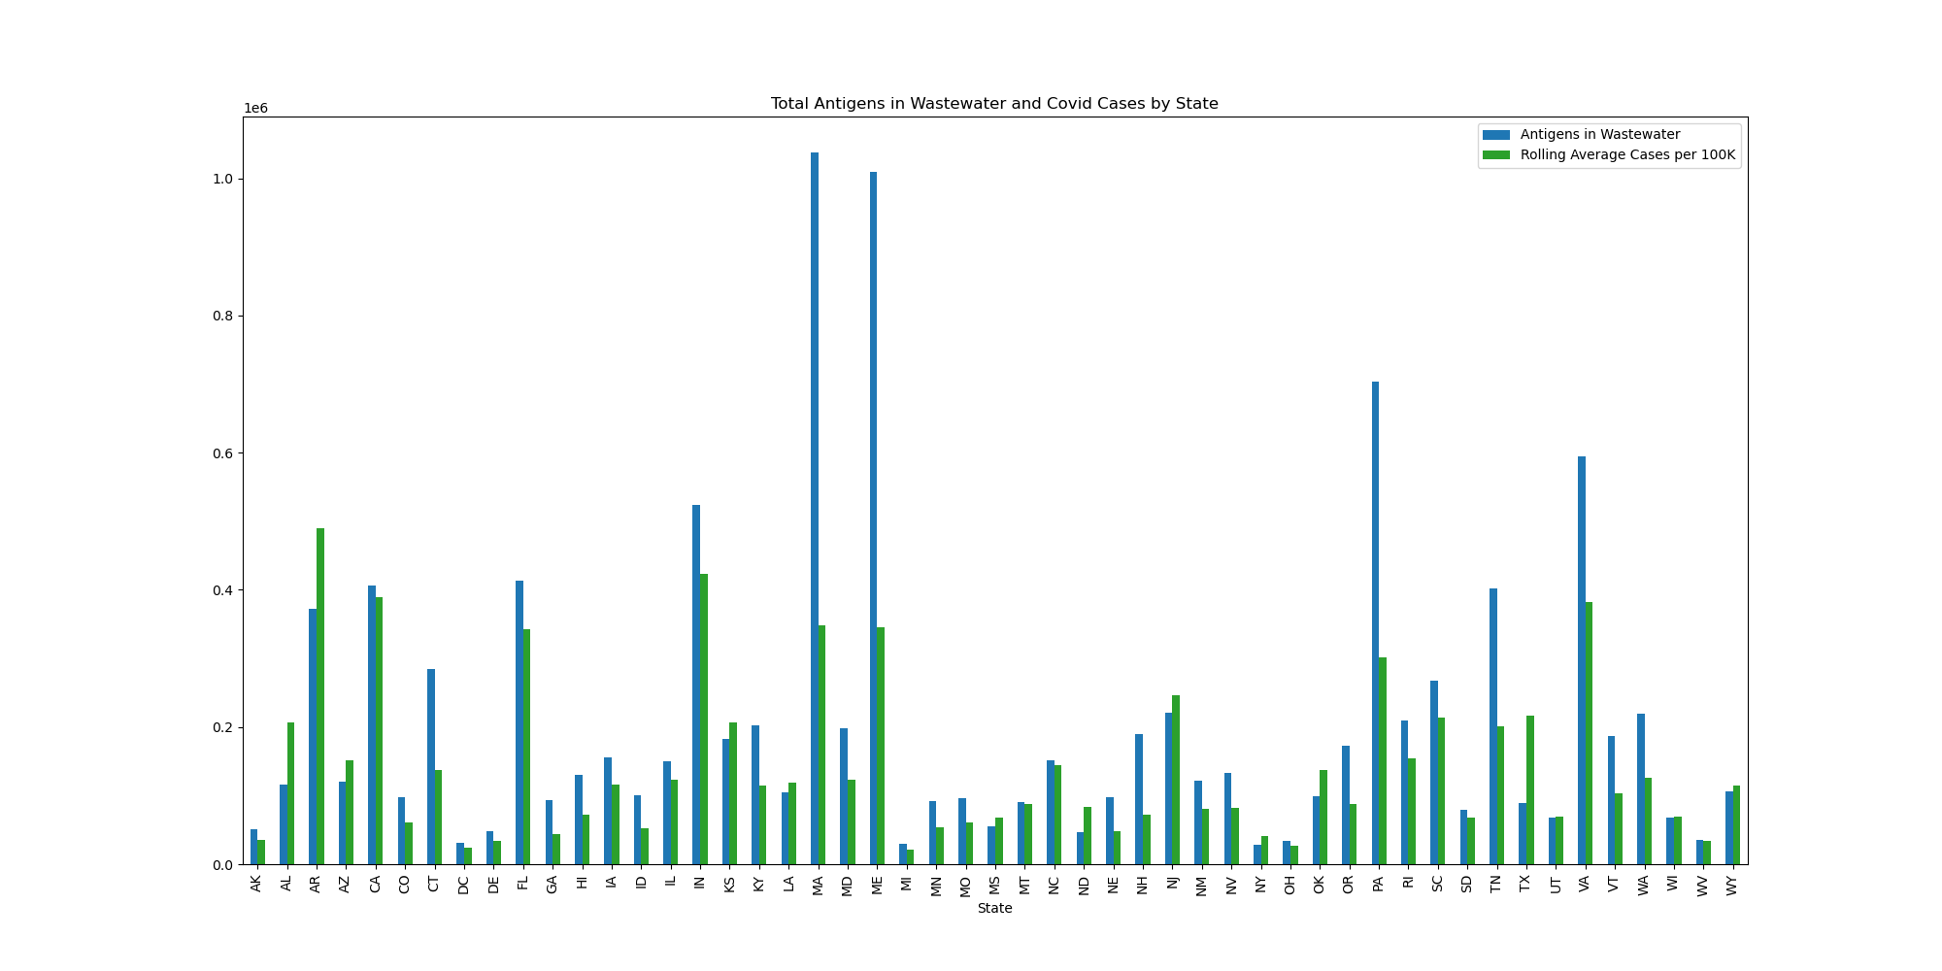
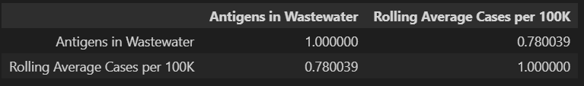
TOTAL ANTIGENS IN WASTEWATER AND COVID CASES BY STATE

Slide 6

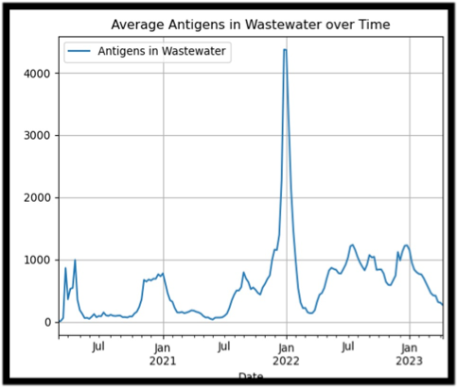
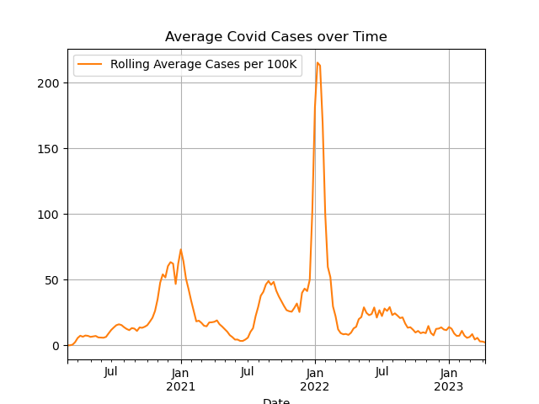
AVERAGE ANTIGENS IN WASTEWATER OVER TIME
AVERAGE COVID CASES OVER TIME

Slide 7
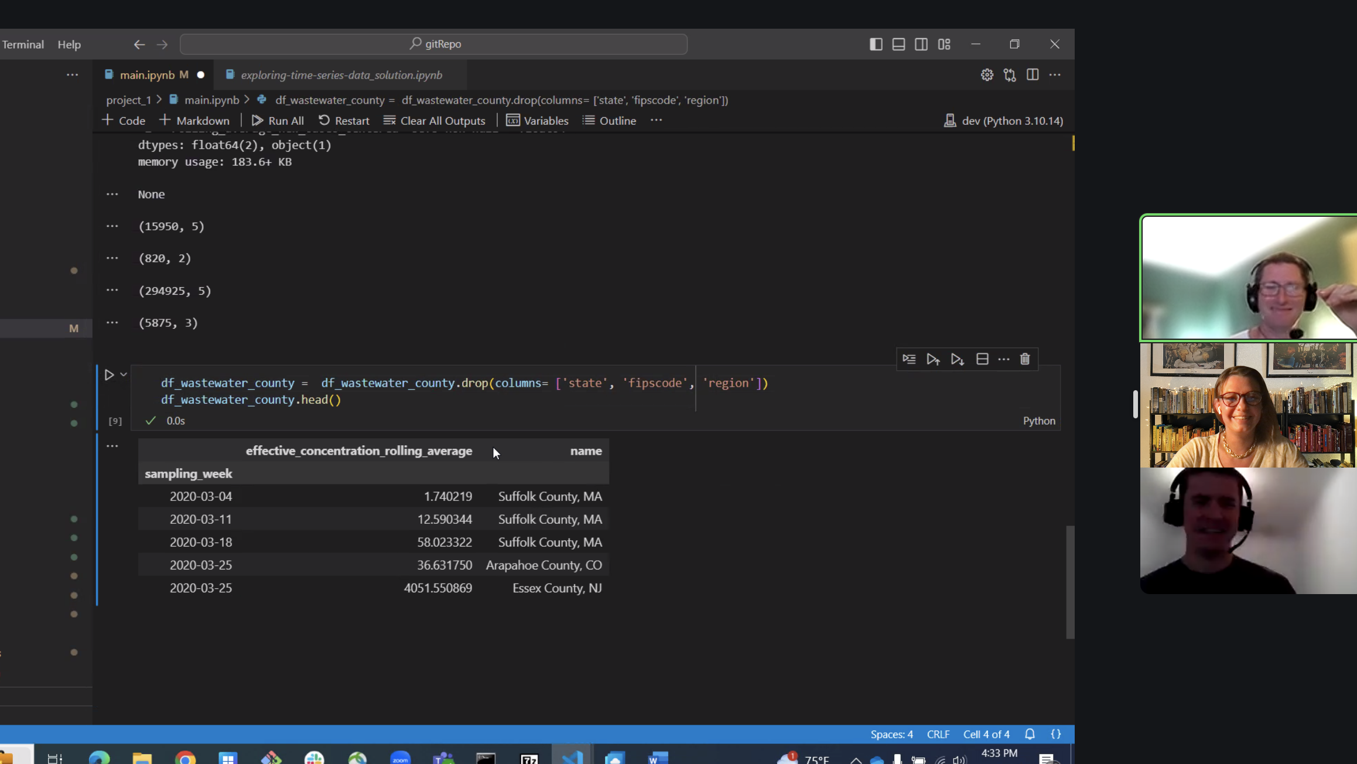
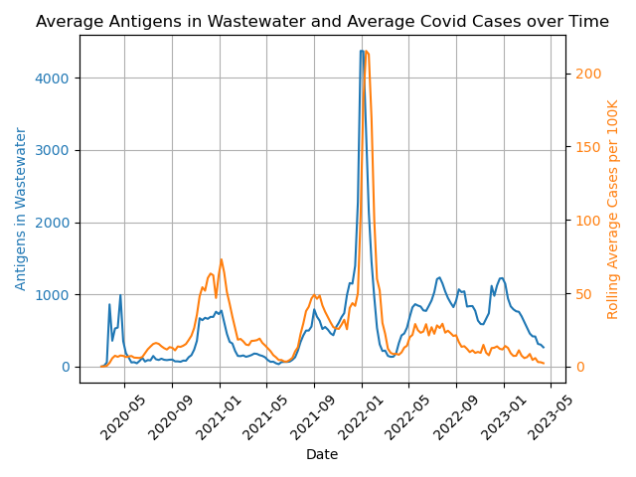
AVERAGE ANTIGENS IN WASTEWATER AND AVERAGE COVID CAES OVER TIME

Slide 8


WHAT DOES THE WATER TELL US, ABOUT US?
EXPLANATORY
RELATIVELY STRONG CORRELATION
SEASONALITY
VACCINE

Slide 9

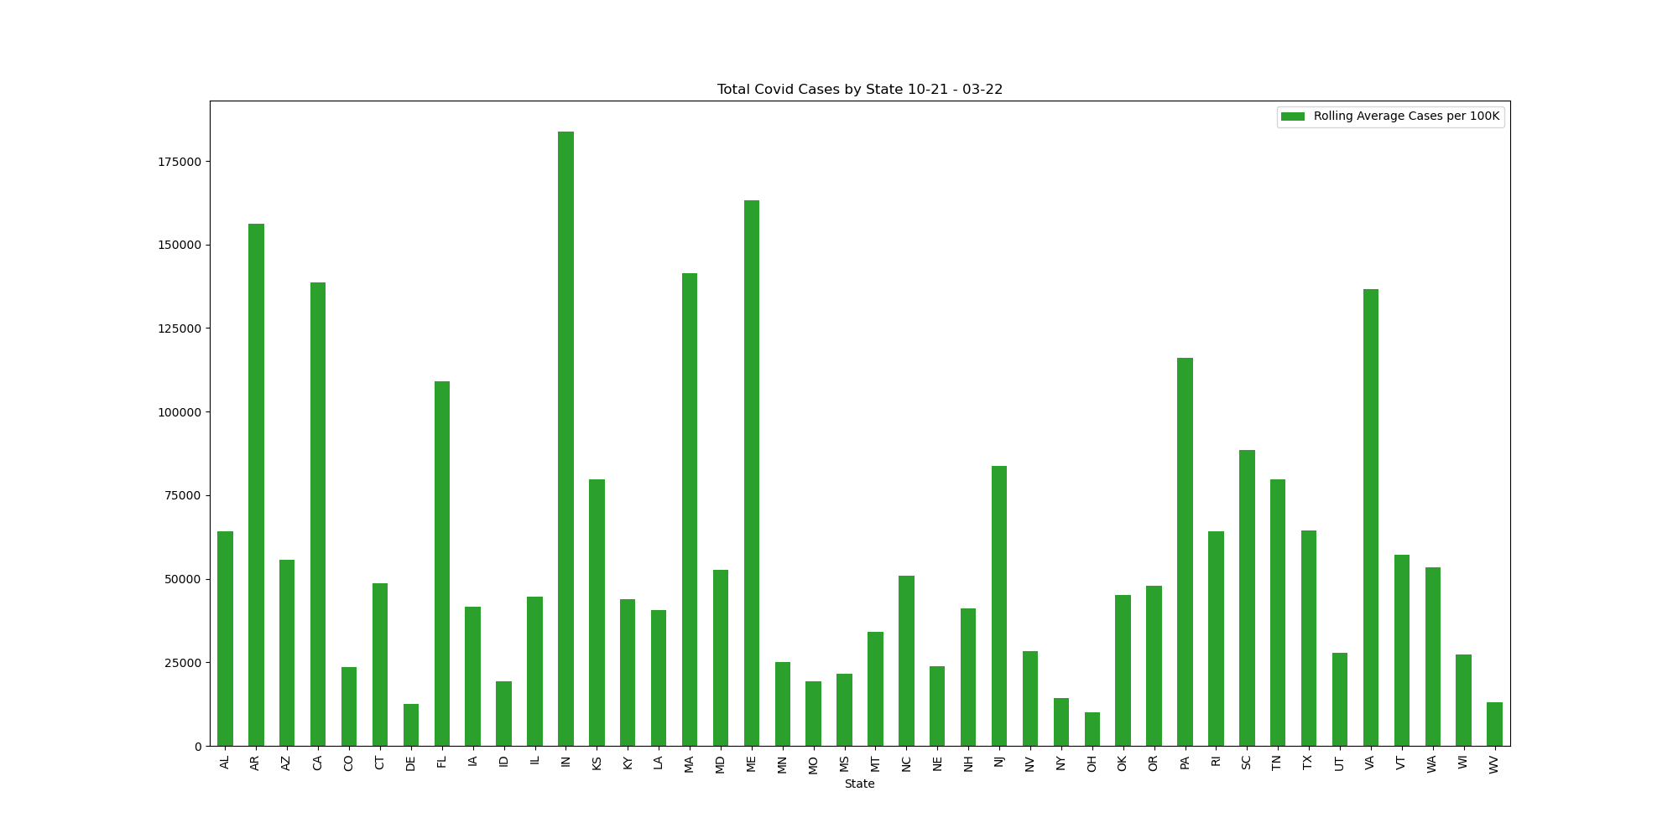
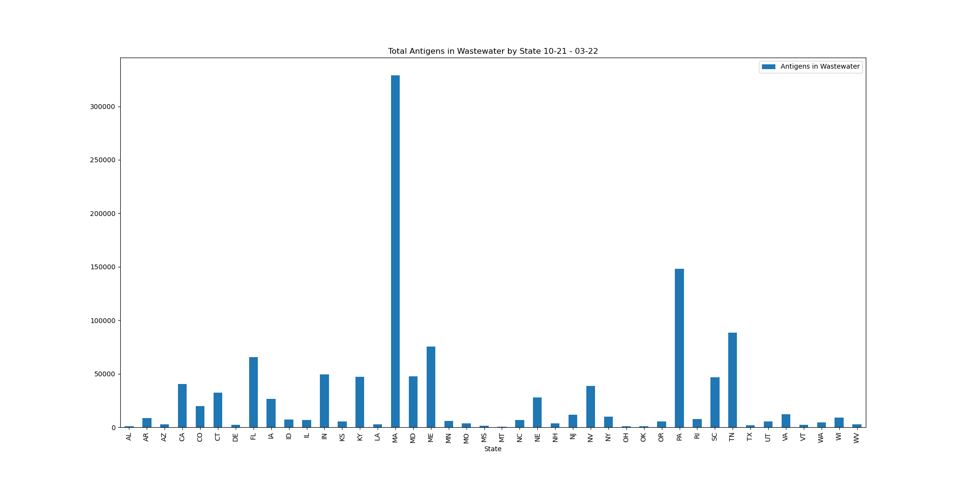
TOTAL COVID CASES BY STATE
OCTOBER 2021- MARCH 2022
TOTAL ANTIGENS IN WASTEWATER BY STATE
OCTOBER 2021-
MARCH 2022

Slide 10
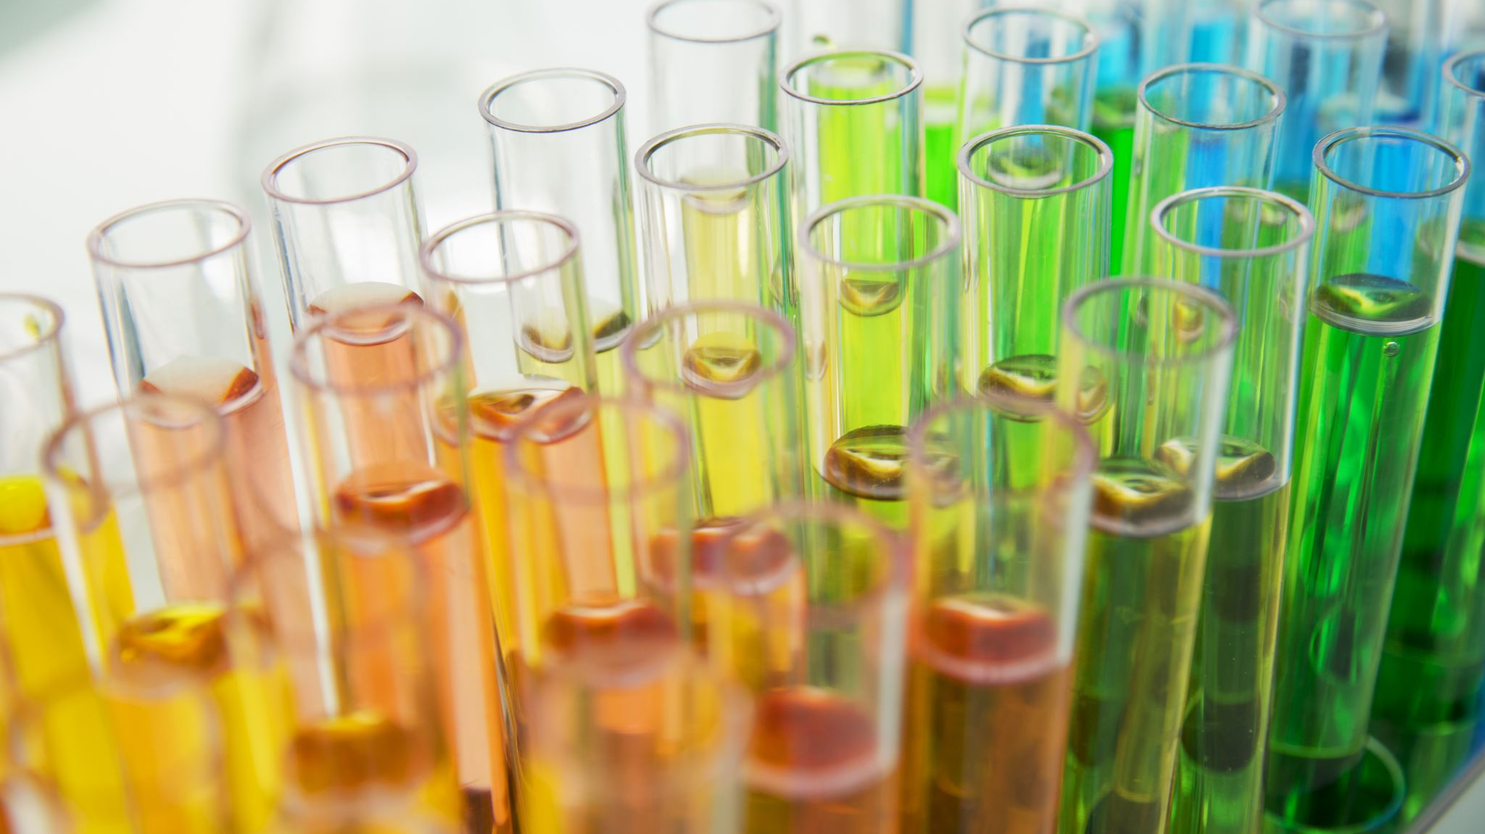
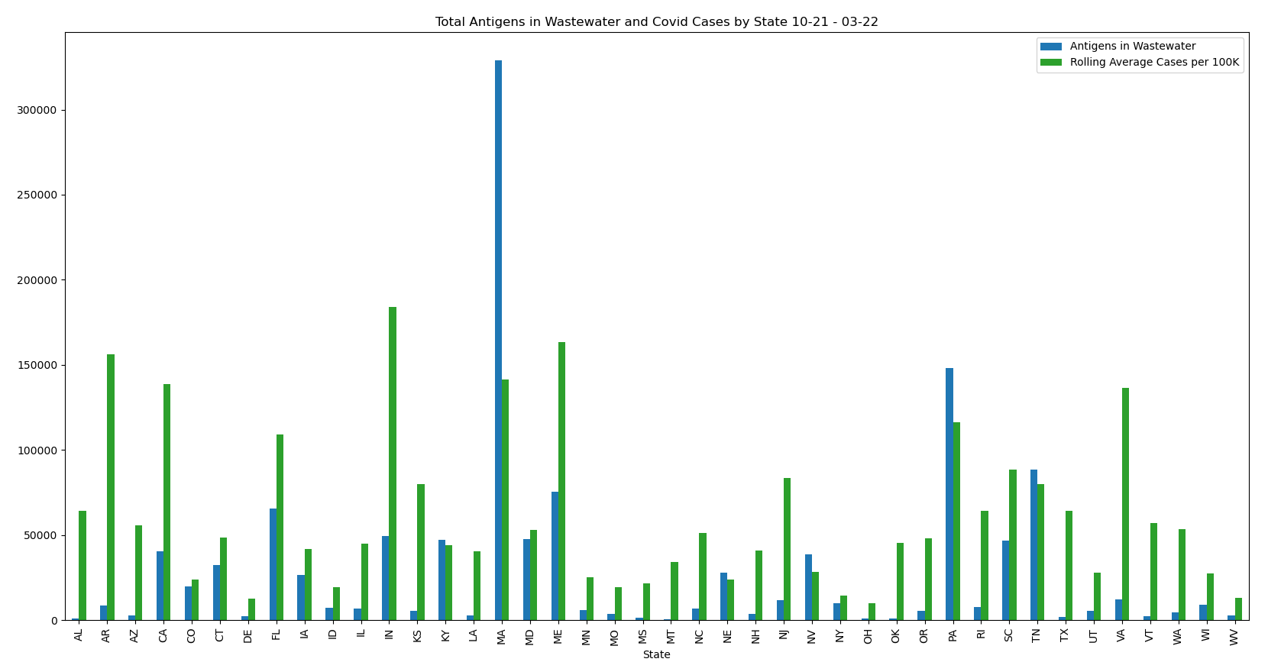
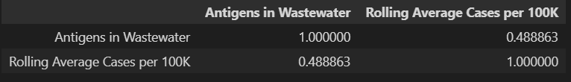
TOTAL ANTIGENS IN WASTEWATER AND COVID CASES BY STATE
OCTOBER 2021 – MARCH 2022

Slide 11
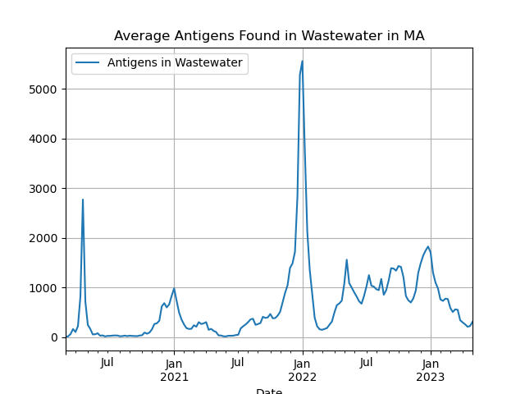
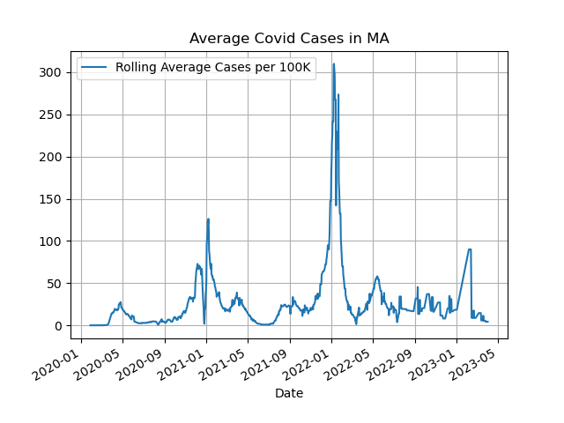
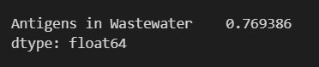
AVERAGE ANTIGENS FOUND IN WASTEWATER IN MASSACHUSETTES
AVERAGE COVID CASES IN MASSACHUSTETTES

Slide 12
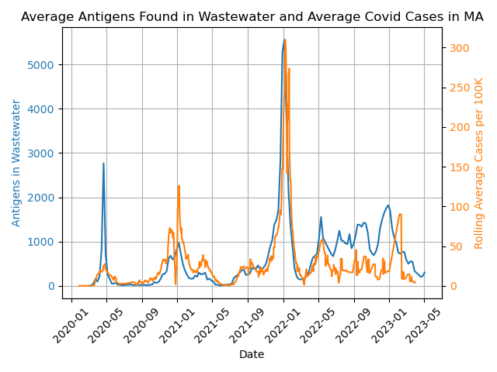
AVERAGE ANTIGENS FOUND IN WASTEWATER AND AVERAGE COVID CASES IN MASSACHUSETTES

Slide 13
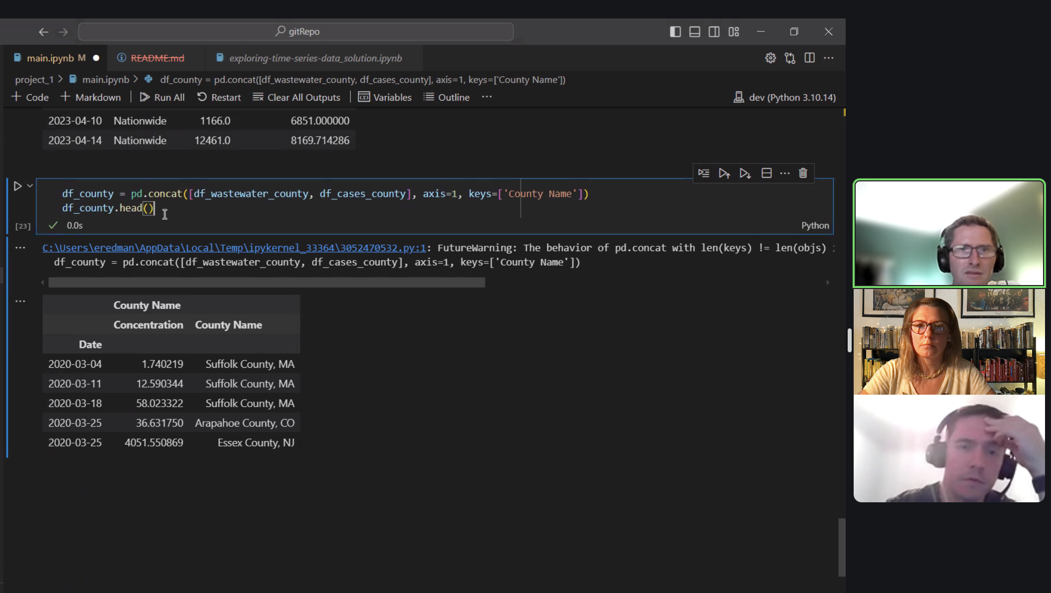
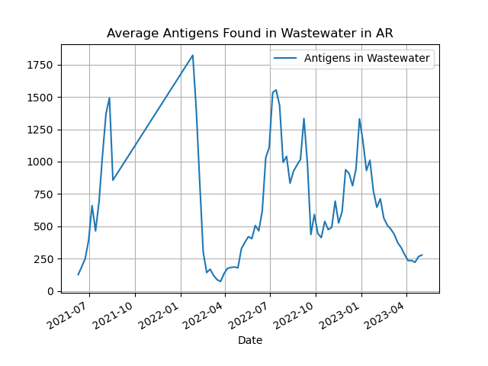
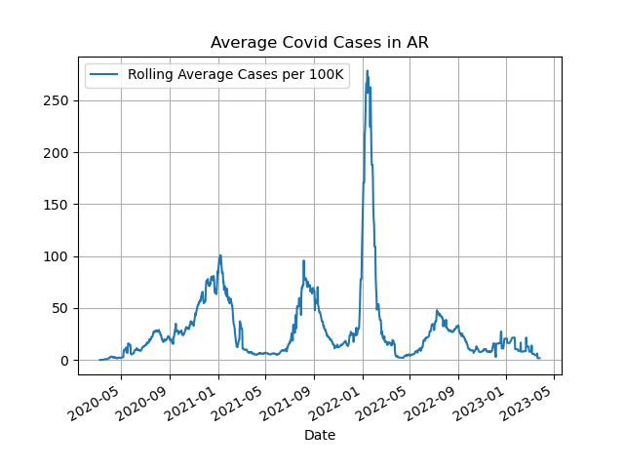
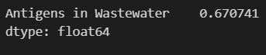
AVERAGE COVID CASES IN ARKANSAS
AVERAGE ANTIGENS FOUND IN WASTEWATER IN ARKANSAS

Slide 14
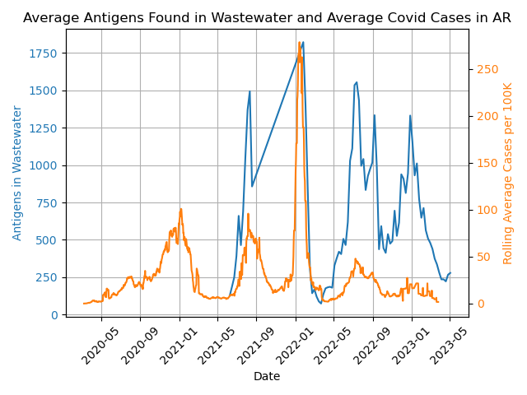
AVERAGE ANTIGENS FOUND IN WASTEWATER AND AVAERAGE COVID CASES IN ARKANSAS

Slide 15

SUPPLY OF DATA
AGGREGATING MULTIPLE DATA SETS WITH UNIQUE MEASUREMENTS
-GEOGRAPHICALLY
-LACK OF REPORTING
-MECHANICS OF WASTEWATER PROCESSING

Slide 16
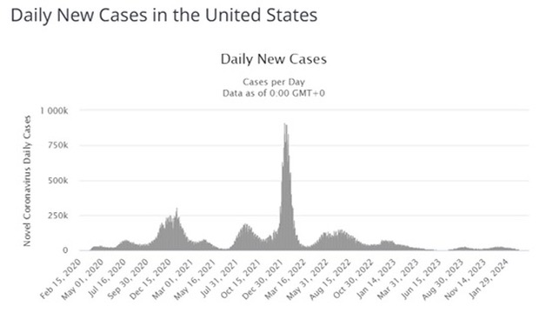
UNITED STATES COVID CORONAVIRUS STATISTICS WORLDOMETER
EXAMPLE OF POPULATION DATA

Slide 17

Q & A
HOW COULD AI BE USED TO ASSIST THE METHOD IN WHICH HEALTH AND ENVIRONMENTAL DATA IS COLLECTED, ANALYZED, AND UTILIZED?
IF A PANDEMIC WERE TO EVER HAPPEN AGAIN, WHAT HAVE WE LEARNED FROM THIS DATA IN ORDER TO TAKE A PROACTIVE APPROACH RATHER THAN REACTIVE?
https://github.com/hsi-eredman/project_1

